Slide 1

CUSTOMER CHURN PREDICTION & SEGMENTATION
Team 7
Cheng Jie G2000455H Li Ziye G2000873G
Lyu Yunfan G2000805D Ma Yuqing G2000305E
Wang Lyu G2003525C

Slide 2

T7
Customer Churn Prediction & Segmentation
Agenda
Business Problem Statement --------------------------------------------------------- Wang Lyu
Exploratory Data Analysis ------------------------------------------------------------- Lyu Yunfan
Model Building
Customer Churn Prediction ----------------------------------------------------- Li Ziye
Customer Segmentation --------------------------------------------------------- Ma Yuqing
Conclusion------------------------------------------------------------------------------- Cheng Jie
Presenter: Wang Lyu

Slide 3

T7
Background —— Business Problem Statement
Background
Customer Retention Increase Profitability
Conduct Churn Management
EDA
The cost of acquiring a new customer can be higher than that of retaining a customer by as much as 700%.
Long-term customers tend to produce more profits.
According to research, a bank can increase its profits by up to 85 % by improving the retention rate by up to 5 %.
Prediction
Clustering
Conclusion
Presenter: Wang Lyu

Slide 4

T7
Background —— Business Problem Statement
Background
Churn Management
To identify those customers who intend to close their accounts, especially those tend to move their accounts to competing service providers.
Once identified, these customers can be targeted with proactive marketing campaigns for retention efforts.
EDA
Prediction
Clustering
Conclusion
Optimize Retention Efforts
Attempting to retain customers that have no intention of churning will waste resource.
Not all customers are worth retaining.
Presenter: Wang Lyu

Slide 5
T7
Background —— Solutions
Background
Customer Churn Prediction
Identify customers who have the tendency to churn with high accuracy, reduce waste of retention efforts.
Find indicators of customer churn according to feature importance, help propose appropriate marketing strategies, facilitate monitoring customer churn into automated, intelligent process.
EDA
Prediction
Clustering
Conclusion
Customer Segmentation
Identify groups of customers worth retaining.
Arrange marketing campaigns for retention more effectively and appropriately according to the customer portrait.
Presenter: Wang Lyu

Slide 6


T7
Exploratory Data Analysis —— Churn Prediction Dataset
Background
EDA
Prediction
Churn Prediction Dataset
Clustering
This data set contains details of a bank's customers and the target variable is a binary variable reflecting the fact whether the customer left the bank (closed his account) or he continues to be a customer.
Conclusion
Presenter: Lyu Yunfan
Notes:
OK now Before we can raising any advice or conclusion, we must find some data to train and deploy our model. so now it’s my turn to conduct the EDA----exploratory data analysis.
The first dataset is about churn prediction. It contains details of a bank's customers
and the target variable is a binary variable reflecting the fact whether the customer left the bank or not

Slide 7
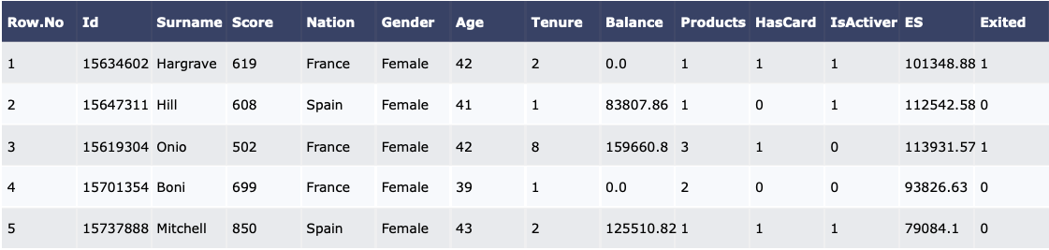
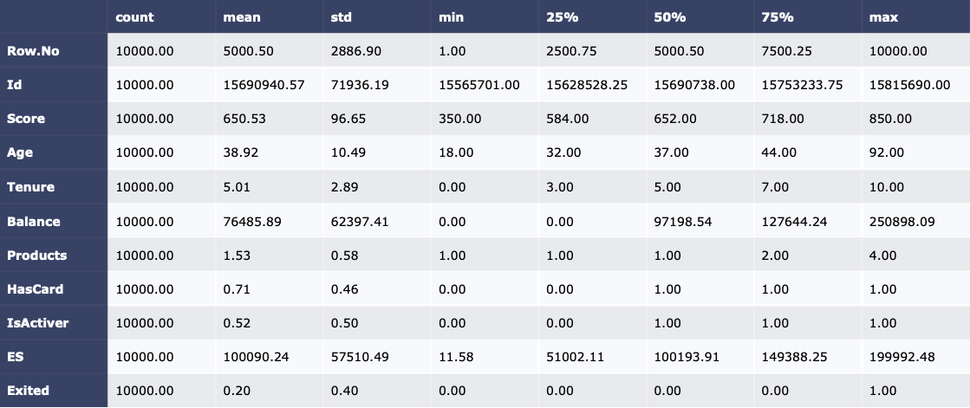
T7
Exploratory Data Analysis —— Churn Prediction Dataset Summary
Fig : First 5 rows data
Background
EDA
Prediction
Clustering
1) Surname : The surname of the customer
2) CreditScore : The credit score of the customer
3) Geography : The country of the customer(Germany/France/Spain)
4) Gender : The gender of the customer (Female/Male)
5) Age : The age of the customer
6) Tenure : The customer's number of years in the in the bank
7) Balance : The customer's account balance
8) NumOfProducts : The number of bank products that the customer uses
9) HasCrCard : Does the customer has a card? (0=No,1=Yes)
10) IsActiveMember : Does the customer has an active membership (0=No,1=Yes)
11) EstimatedSalary : The estimated salary of the customer
12) Exited : Churned or not? (0=No,1=Yes)
Conclusion
Fig : Data Interpretation
Fig : Descriptive statistics
Presenter: Lyu Yunfan
Notes:
The first few rows looks like this as you can see I put here, and there are 6 numerical variable and 5 categorical variable.
The right chart shows us the descriptive statistics.

Slide 8
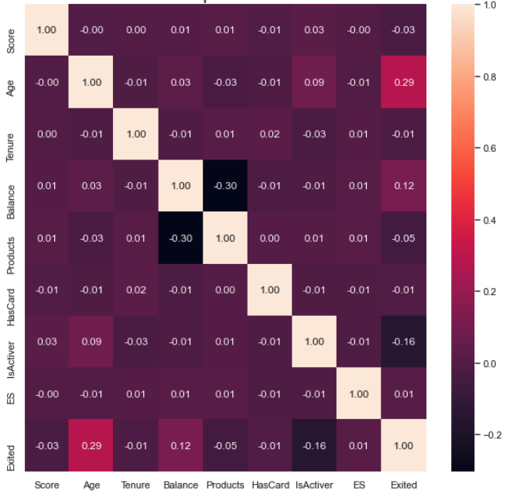
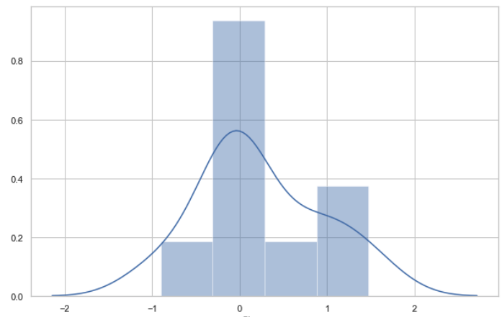
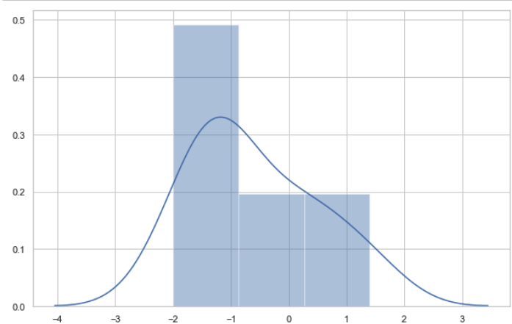
T7
Exploratory Data Analysis —— Correlation& Skewness& Kurtosis
Background
EDA
Prediction
Fig : Skewness of all numeric data
Clustering
Conclusion
Fig : Heat map of data correlation
Fig : Kurtosis of all numeric data
Presenter: Lyu Yunfan
Notes:
The left chart is Heat map of data correlation and as you can see from the picture, there’s no any highly correlated variable with y,
variable age has the biggest correlation with y at 0.29.
From the right chart we can conclude that the The data is relatively symmetric

Slide 9
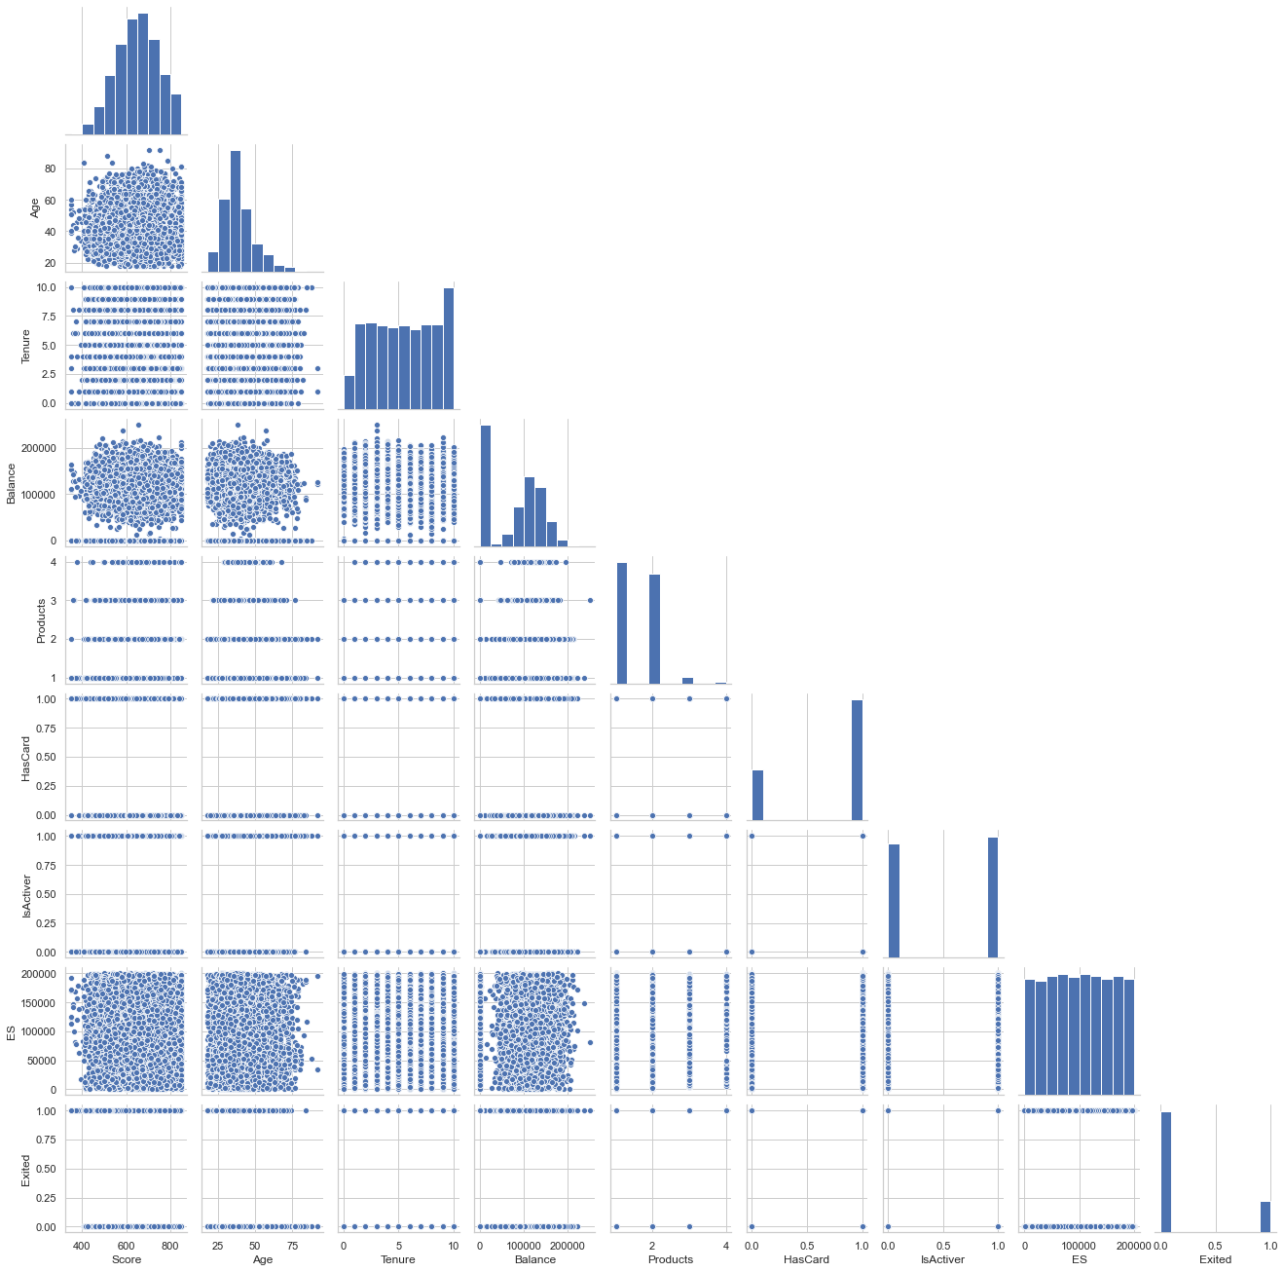
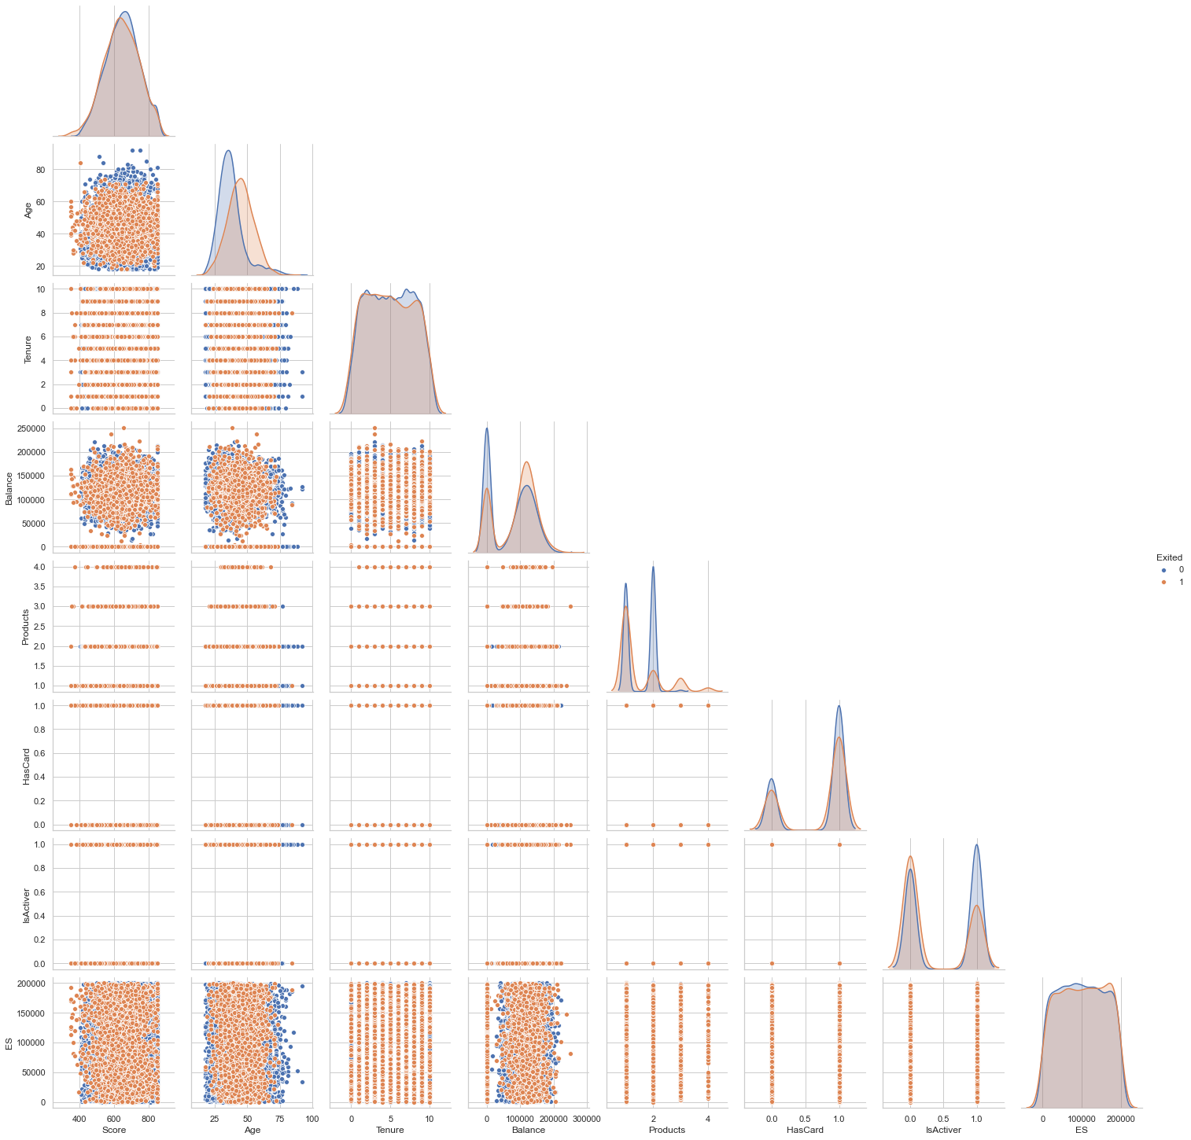
T7
Exploratory Data Analysis —— Pair Plot
Background
EDA
Prediction
Clustering
Conclusion
Fig : Pair Plot
Presenter: Lyu Yunfan
Notes:
This is the pair plot, You can see the distribution relationship between any two variables
if you are interested, you can click the pause and stop for a while

Slide 10
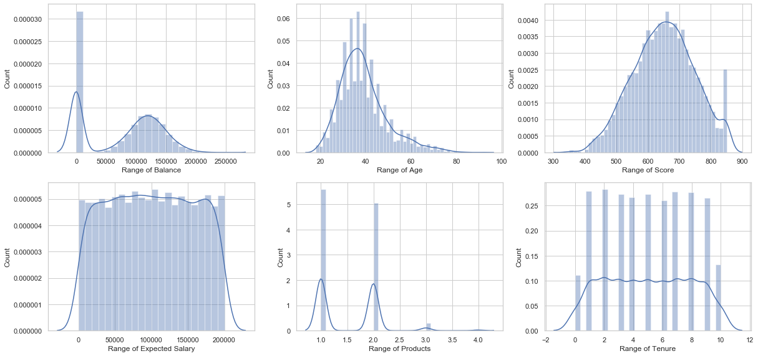
T7
Exploratory Data Analysis —— Simulated distribution curve of numerical variables
Background
EDA
Prediction
Clustering
Conclusion
Fig : Simulated distribution curve of numerical variables
Presenter: Lyu Yunfan
Notes:
This is the Simulated distribution curve of numerical variables
we can see variable balance, age and credit score present a normal distribution.
We should also noticed that
firstly many customers have outstanding balance at 0,
secondly the sum of people having different expected salary is very close and
thirdly most customers have 1 or 2 product.

Slide 11
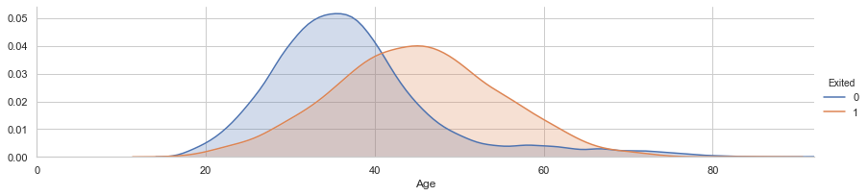
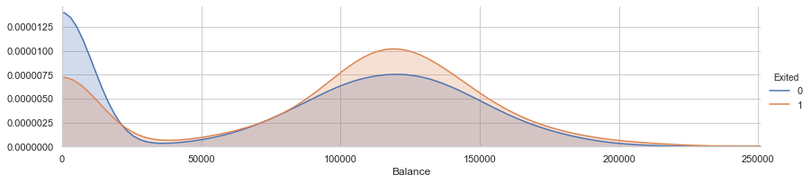
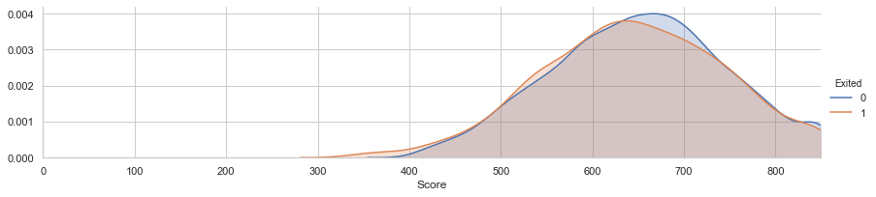
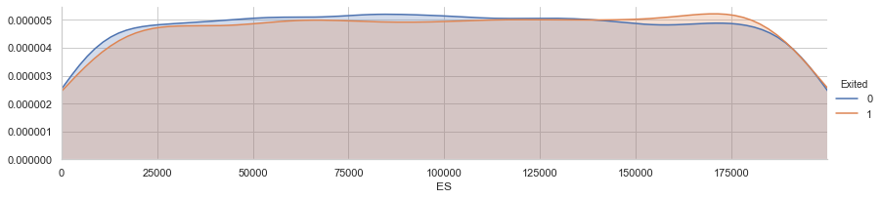
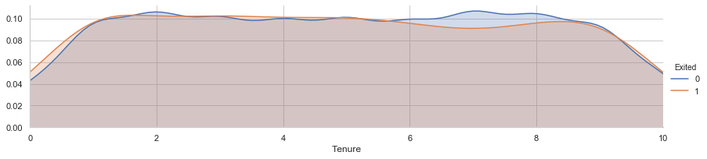
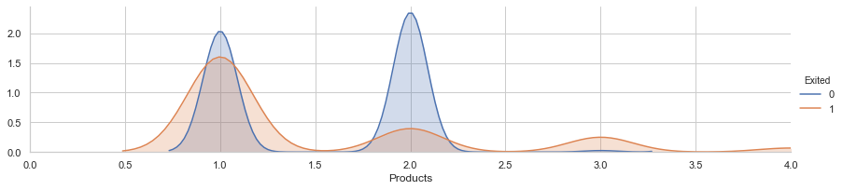
T7
Exploratory Data Analysis —— Distribution of numerical variables given different exited situation
Background
EDA
Prediction
Clustering
Conclusion
Fig : Distribution of numerical variables given different exited situation
Presenter: Lyu Yunfan
Notes:
Chart in this page is about the Distribution of numerical variables given different exited situation.
We can notice that older people have more chance to exit, maybe because They have a more cautious attitude towards investment.
And we can also see from the balance chart, more people with zero outstanding balance choose not to exit.

Slide 12
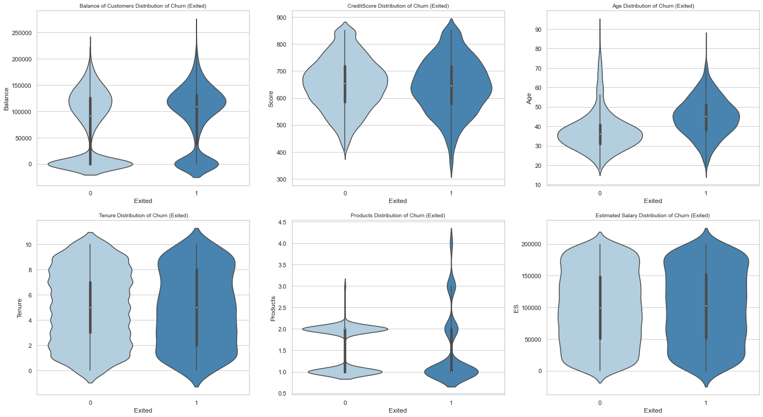
T7
Exploratory Data Analysis —— Distribution of numerical variables given different exited situation
Background
EDA
Prediction
Clustering
Conclusion
Fig : Distribution of numerical variables given different exited situation
Presenter: Lyu Yunfan
Notes:
This diagram illustrates the same fact, we used the violin diagram instead

Slide 13
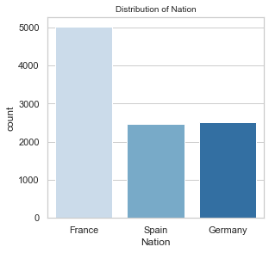
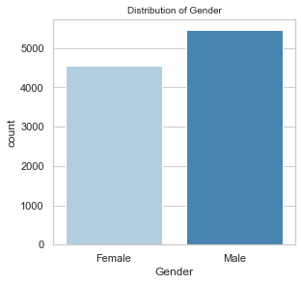
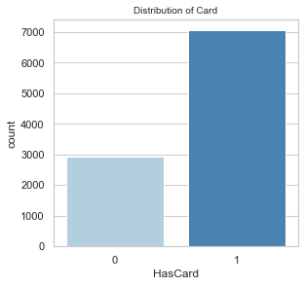
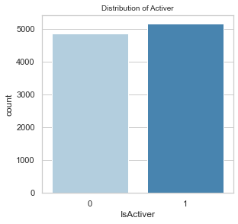
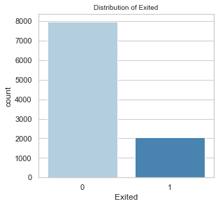
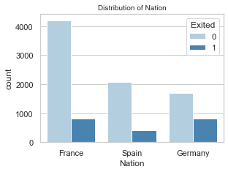
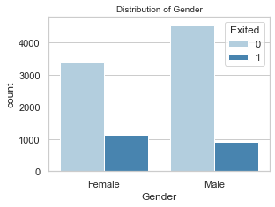
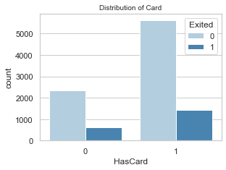
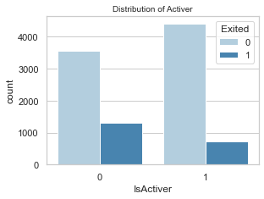
T7
Exploratory Data Analysis —— Categorical Variables Summary
Fig : Distribution of categorical variables
Background
EDA
Prediction
Clustering
Fig : Distribution of categorical variables given different exited situation
Conclusion
Presenter: Lyu Yunfan
Notes:
This page is about the Distribution of categorical variables and the Distribution of categorical variables given different exited situation
I think the second diagram can’t see clearly let’us move the next page.

Slide 14
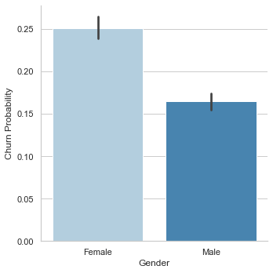
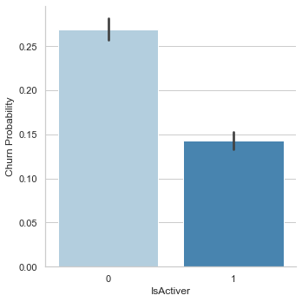
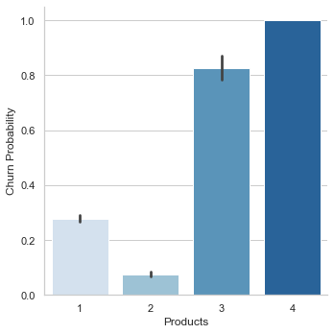
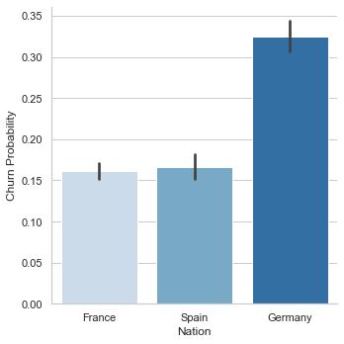
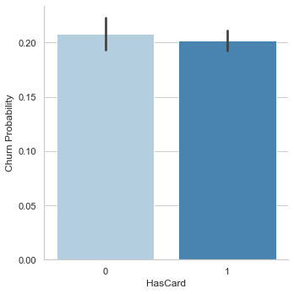
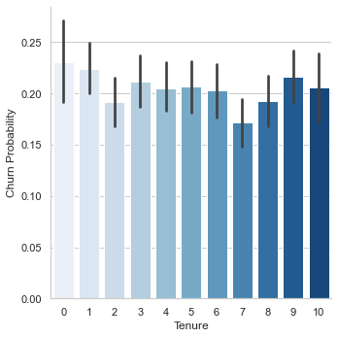
T7
Exploratory Data Analysis —— Churn probability of categorical variables
Background
EDA
Prediction
Clustering
Conclusion
Fig : Churn probability of categorical variables
Presenter: Lyu Yunfan
Notes:
This diagram shows us that
Female has more tendency to exit than male.
When the account is active, customer tend not to exit.
Customers who have many products tend not to exit.
Germany, compared to others countries residence, tend not to exit.

Slide 15
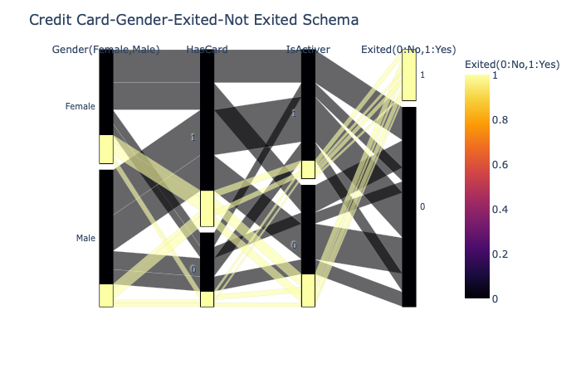
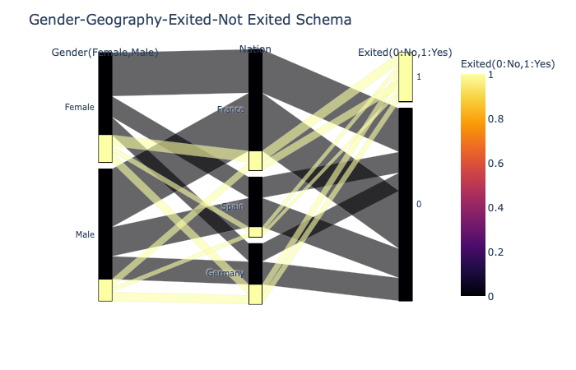
T7
Exploratory Data Analysis —— Card-Gender-Exited-Not Exited Schema
Background
EDA
Prediction
Clustering
Conclusion
Fig : Credit Card-Gender-Exited-Not Exited Schema
Fig : Gender-Geography-Exited-Not Exited Schema
Presenter: Lyu Yunfan
Notes:
We can see from the scheme that
Around 20% of people exited.
As before
Females Germans have more tendency to exit.
French female numerically exited more (460)
Frenchs continued with a bank numerically and proportionally most
Females and unactive members more prone to exit.
Credit card users are also a bit more prone to exit than non credit card users.
Then my team mate will show you how to use this data do conduct churn prediction

Slide 16


T7
Customer Churn Prediction —— Overview of Solution
Background
EDA
Prediction
Customer Churn Prediction
Clustering
5 machine learning models
logistic regression, decision tree, random forest, XGBoost, and Neural Network.
Feature importance analysis for significant features identification
Conclusion
Presenter: Li Ziye

Slide 17




T7
Customer Churn Prediction —— Two Targets
Target 1: Precisely predict whether a customer will close the account
Background
Improve recall while ensuring a high prediction accuracy
True Label
0
EDA
TN
FP
Unnecessary cost of retention on wrong target customers
Prediction
1
Clustering
FN
TP
Some customer churn that can be avoided
Conclusion
0
1
Predicted Label
0: not churned customer 1:churned customer
Target 2: Significant features identification
Identify which variables play most significant roles in the customer churn prediction model
Presenter: Li Ziye

Slide 18
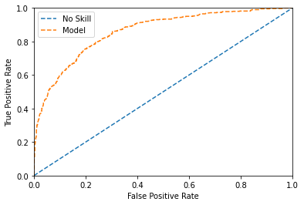
T7
Customer Churn Prediction —— Measurement Metrics and Performance Target
Performance Measurement Metrics
Two Targets
Background
$$Accuracy=\frac{True Positive+True Negative}{Positive+Negative}$$
Overall prediction accuracy of the model
EDA
$$Recall=\frac{True Positive}{True Positive+False Negative}$$
Prediction
Rate of precisely predicting customer churn
Clustering
$$\left.Area Under roc Curve(AUC\right)$$
The measure of the ability of a classifier
Conclusion
Performance Target
Accuracy > 70%
Recall > 70%
AUC > 0.800
Fig : ROC Curve
Presenter: Li Ziye

Slide 19
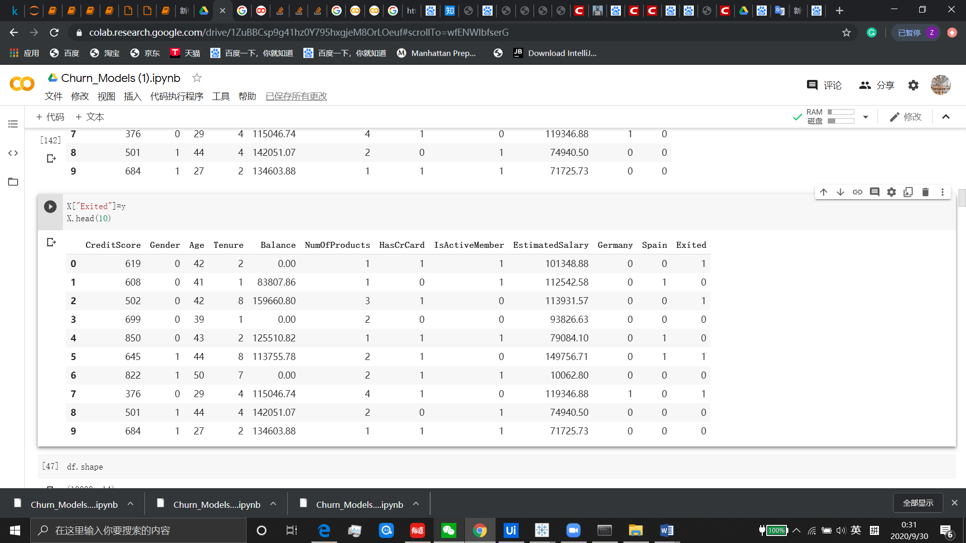
T7
Customer Churn Prediction —— Data Preprocessing
Process missing value and outliers
Remove irrelevant variables (RowNumber, CustomerID, Surname)
One-hot encoding on categorical variable (Gender and Geography)
Split the data frame on a train and test basis with 0.7 split ratio
Scale X to around 0 to 1 with MinMaxScaler()
Over-sampling on trainset with SMOTE to convert imbalanced dataset to balanced one
Background
EDA
Prediction
Clustering
Conclusion
x0 – x10
Y
Presenter: Li Ziye

Slide 20
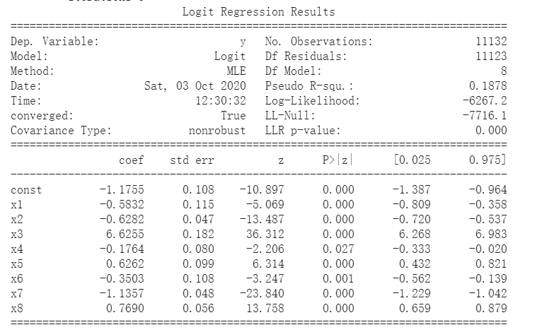
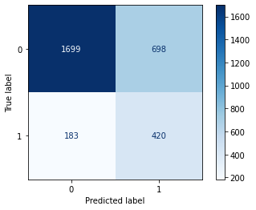
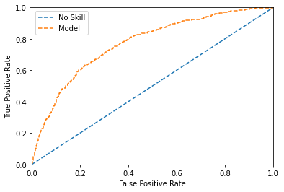
T7
Customer Churn Prediction —— Model building 1 (Logistic Regression)
Logistic Regression Model
Logistic Regression Model
Background
remove insignificant variables at 5% level
EDA
Improved Logistic Regression Model
Improved Logistic Regression Model
Prediction
Clustering
Conclusion
Fig : Logit Regression Results
Fig : Confusion Matrix(testset)
Fig : ROC Curve
Indicators | Accuracy | Recall | AUC
Logistic Regression | 70.63% | 69.65% | 0.770
Presenter: Li Ziye

Slide 21
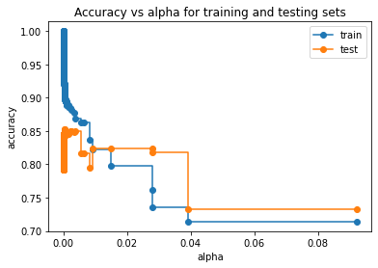
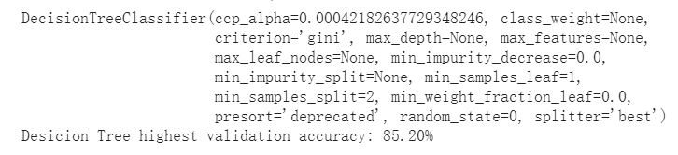
T7
Customer Churn Prediction —— Model building 2 (Decision Tree)
Decision Tree Model
Background
post-pruning to avoid overfitting
EDA
Improved Decision Tree Model
Prediction
Clustering
Conclusion
Fig : relationship between ccp_alpha and accuracy for trainset and testset
Fig : highest accuracy and corresponding ccp_alpha
Indicators | Accuracy | Recall | AUC
Decision Tree | 76.53% | 74.96% | 0.831
Presenter: Li Ziye

Slide 22
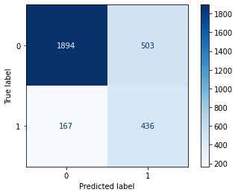
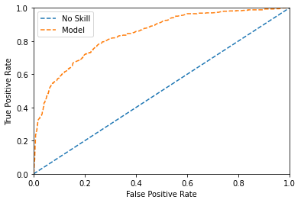
T7
Customer Churn Prediction —— Model building 3 (Random Forest)
Background
Adjust resample ratio and parameters in the model, like n_estimators and max_depth, and conduct feature selection to obtain a satisfactory result
EDA
Prediction
Clustering
Conclusion
Fig : Confusion Matrix(testset)
Fig : ROC Curve
Indicators | Accuracy | Recall | AUC
Random Forest | 77.67% | 72.31% | 0.844
Presenter: Li Ziye

Slide 23
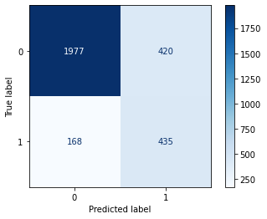
T7
Customer Churn Prediction —— Model building 4 (XGBoost)
Background
Adjust resample ratio and parameters in the model and conduct feature selection to obtain a desirable result
EDA
Prediction
Clustering
Conclusion
Fig : Confusion Matrix(testset)
Fig : ROC Curve
Indicators | Accuracy | Recall | AUC
XGBoost | 80.40% | 72.14% | 0.859
Presenter: Li Ziye

Slide 24
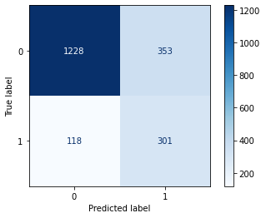
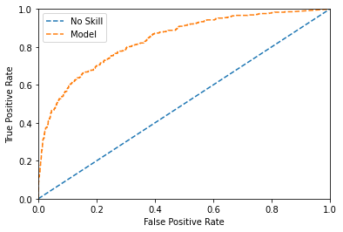
T7
Customer Churn Prediction —— Model building 5 (Neural Network)
Background
Adjust resample ratio and parameters in the model, like n_estimators and max_depth, and conduct feature selection to obtain a satisfactory result
EDA
Prediction
Clustering
Conclusion
Fig : Confusion Matrix(testset)
Fig : ROC Curve
Indicators | Accuracy | Recall | AUC
Neural Network | 76.45% | 71.84% | 0.838
Presenter: Li Ziye

Slide 25

T7
Customer Churn Prediction —— Result Comparison
Background
Indicators | Accuracy | Recall | AUC
Logistic Regression | 70.63% | 69.65% | 0.770
Decision Tree | 76.53% | 74.96% | 0.831
Random Forest | 77.67% | 72.31% | 0.844
XGBoost | 80.40% | 72.14% | 0.859
Neural Network | 76.45% | 71.84% | 0.838
EDA
Prediction
Clustering
Fig : 5 Model Result Comparison
Conclusion
XGBoost is the best model for customer churn prediction!
Presenter: Li Ziye

Slide 26
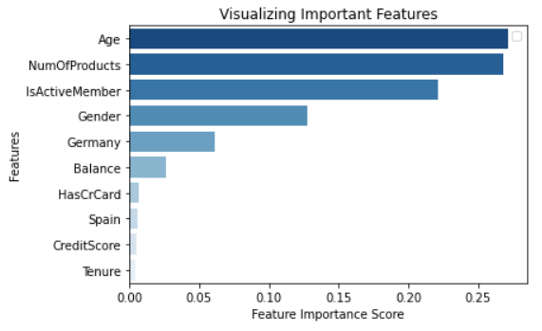
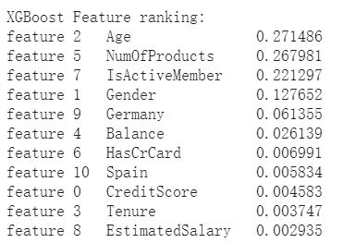
T7
Customer Churn Prediction —— Significant features identification
Background
Age, Number of Products, Is Active Member or not, Gender, Germany
Contribute 95% to the optimal model (XGBoost)
EDA
Prediction
Clustering
Conclusion
Fig : Feature importance for XGboost
Presenter: Li Ziye

Slide 27






T7
Customer Churn Prediction —— Future Improvement on model
1 Adjust measurement metrics
2 Gather more customer data into model
Background
Gather more customer data from enterprise
(identity information and behavioral information)
Enterprise’s business needs
EDA
Prediction
Adjust the parameters of model
(threshold, resample ratio, etc.)
Clustering
Fit the model
Conclusion
Trade off
the Ture Positive Rate (Recall)
and True Negative Rate
Improve prediction ability
Presenter: Li Ziye

Slide 28
T7
Exploratory Data Analysis —— Customer Segmentation Dataset
Background
EDA
Prediction
Customer Segmentation Dataset
Clustering
This dataset contains data from a marketing campaign that aimed to capture time deposits. With this data, it is possible to use classification techniques and profile customers. The data of the clients approached were divided into 17 attributes, being 8 numeric classes and 9 of factors. The campaign reached 45211 customers and at the end of the campaign 5286 customers made the deposit.
Conclusion
Presenter: Lyu Yunfan
Notes:
OK next is Customer Segmentation Dataset
This dataset contains data from a marketing campaign that aimed to capture time deposits.
With this data, it is possible to use classification techniques and profile customers.
It’s very similar with the last one ， so I just briefly introduce

Slide 29
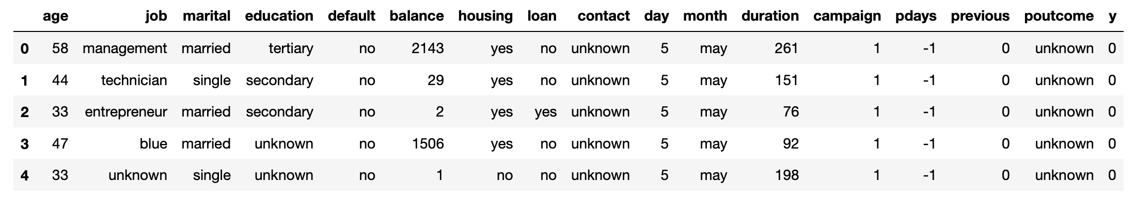
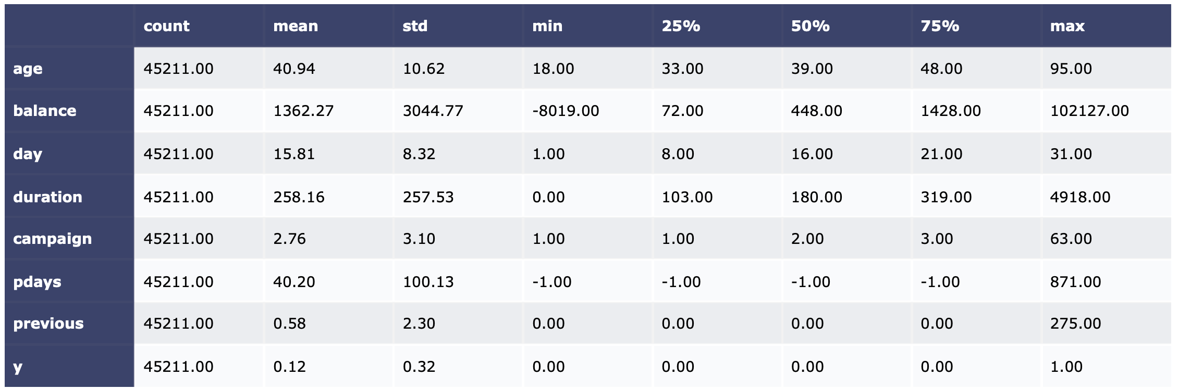
T7
Exploratory Data Analysis —— Customer Segmentation Dataset Summary
Fig : First 5 rows data
Background
EDA
Prediction
Age: The age of the customer
Job: Type of job
Marital: Whether is married
Education: Education level
Default: Has credit in default? (Yes/No)
Balance: Average yearly balance
Housing: Has housing loan? (Yes/No)
Loan: Has personal loan? (Yes/No)
Contact: Contact communication type (unknown/telephone/cellular)
Day: Last contact day of the month
Month: Last contact month of year
Duration: last contact duration, in seconds
Campaign: number of contacts performed during this campaign and for this client
Pdays: number of days that passed by after the client was last contacted from a previous campaign
Previous: number of contacts performed before this campaign and for this client
Poutcome: outcome of the previous marketing campaign (unknown/other/failure/success)
Y: Has the client subscribed a term deposit? (0=No,1=Yes)
Clustering
Conclusion
Fig : Descriptive statistics
Fig : Data Interpretation
Presenter: Lyu Yunfan
Notes:
The data of the customers were divided into 17 attributes,with 8 numeric classes and 9 of factors.

Slide 30
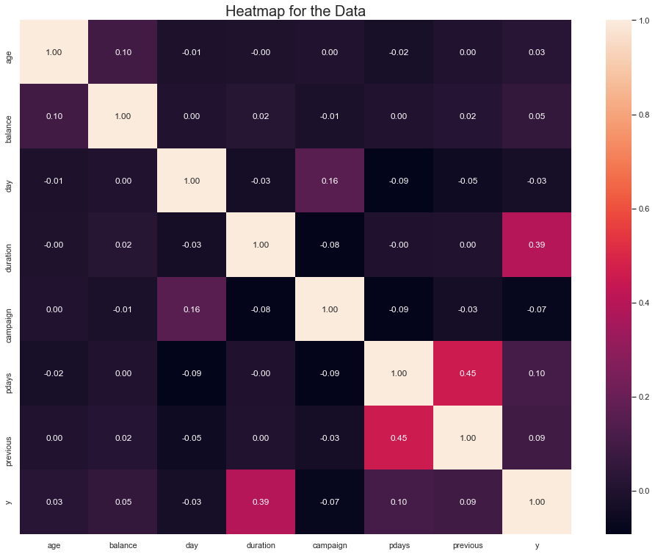
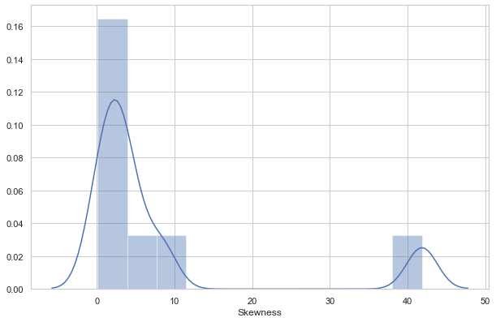

T7
Exploratory Data Analysis —— Correlation& Skewness& Kurtosis
Background
EDA
Prediction
Fig : Skewness of all numeric data
Clustering
Conclusion
Fig : Heat map of data correlation
Fig : Kurtosis of all numeric data
Presenter: Lyu Yunfan
Notes:
Heat map of data correlation shows us that duration has high correlation with y

Slide 31


T7
Exploratory Data Analysis —— Pair Plot
Background
EDA
Prediction
Clustering
Conclusion
Fig : Pair Plot
Presenter: Lyu Yunfan
Notes:
Here is pair plot

Slide 32

T7
Exploratory Data Analysis —— Simulated distribution curve of numerical variables
Background
EDA
Prediction
Clustering
Conclusion
Fig : Simulated distribution curve of numerical variables
Presenter: Lyu Yunfan
Notes:
Simulated distribution curve of numerical variables

Slide 33









T7
Exploratory Data Analysis —— Distribution of numerical variables given different exited situation
Background
EDA
Prediction
Clustering
Conclusion
Fig : Distribution of numerical variables given different exited situation
Presenter: Lyu Yunfan
Notes:
Distribution of numerical variables given different exited situation

Slide 34

T7
Exploratory Data Analysis —— Categorical variables Summary
Background
EDA
Prediction
Clustering
Conclusion
Fig : Distribution of categorical variables
Presenter: Lyu Yunfan
Notes:
We can see from the Distribution of categorical variables

Slide 35







T7
Exploratory Data Analysis —— Success probability of categorical variables
Background
EDA
Prediction
Clustering
Conclusion
Fig : Success probability of categorical variables
Presenter: Lyu Yunfan
Notes:
And Success probability ,and find that
single people who are well educated are more likely to accept out product.
People don’t have house loan are more likely to accept out product
Next my teammeat will show you how to use this data to conduct customer segmatation

Slide 36

T7
Model Building - Customer Segmentation
Background
EDA
Prediction
Customer Segmentation
Clustering
This part introduces how we implement customer segmentation to dive customers into groups based on their personal information and purchase patterns so that we can identify the profitable groups when they tend to churn.
Conclusion
Presenter: Yuqing Ma

Slide 37
T7
Customer Segmentation - Clustering Algorithm - Partitioning Around Medoids (PAM)
Background
Partitioning Around Medoids (PAM):
EDA
The method partitions our data into k clusters.
Why do we not choose K-Means?
Prediction
The dataset is mixed with both numerical and categorical values – “Gower Distance”.
K-Means which uses mean value as the clustering centroid is very sensitive to outliers in the dataset.
Clustering
Conclusion
Clustering objective?
Obtain a clear and separated group of clusters with understandable and representable features.
Presenter: Yuqing Ma

Slide 38

T7
Customer Segmentation - Optimal number of clusters
Background
Silhouette Coefficient:
A value used to quantity how well the clustering has performed by studying the separation distance between the resulting clusters.
EDA
Prediction
Clustering
K=5 has the highest Silhouette Width 0.27
Thus, we cluster our customers into 5 different subgroups.
Conclusion
Fig : Plot of Silhouette Coefficient K=1 to 5
Presenter: Yuqing Ma

Slide 39

T7
Customer Segmentation - Customer Portrait
Cluster 1: Successful Young People
Background
94% are highly educated with a tertiary degree.
Second youngest among the five clusters and achieve great success in their career with 65% management, 10% technician and 7% entrepreneur.
Most of them are married and have house loans.
EDA
Prediction
Clustering
Conclusion
Group with highest growing value !
Presenter: Yuqing Ma

Slide 40

T7
Customer Segmentation - Customer Portrait
Cluster 5: Wealthy Class
Background
Oldest group among the five clusters, half of them work in the management level and 76% are married, living in a stable state of life.
Most are well educated with 59% obtained tertiary degree, 22% obtained secondary degree.
The only group without house loan burden and their bank balance is the highest.
EDA
Prediction
Clustering
Conclusion
Group with highest
profit!
Presenter: Yuqing Ma

Slide 41

T7
Customer Segmentation - Customer Portrait
Cluster 2: Highest Default Risk Group
This is a group that will not be considered as high valued.
The youngest cluster, about half of the customers are technician, while the second and third highest are administration and services profession.
Low overall education background.
Lowest bank balance among the five clusters.
The highest default rate at 2.38%, while the other four groups are all leveled at around 1.87%.
Background
EDA
Prediction
Clustering
Conclusion
Presenter: Yuqing Ma

Slide 42

T7
Customer Segmentation - Customer Portrait
Cluster 3: middle income group
Background
This is a group that will not be considered as high valued.
Middle aged class, most of them has secondary education background.
Overwhelming majority need to pay house loans and their bank balance is not high.
EDA
Prediction
Clustering
Conclusion
Presenter: Yuqing Ma

Slide 43

T7
Customer Segmentation - Customer Portrait
Cluster 4: less educated blue collar
Background
This is a group that will not be considered as high valued.
The lowest education level – 89% of them only attended primary school.
The second oldest group and majority of them work as blue collars.
Low bank balance and high house loans to pay.
EDA
Prediction
Clustering
Conclusion
Presenter: Yuqing Ma

Slide 44

T7
Customer Segmentation - Clusters observed in a lower dimensional space
Visualization on high-dimensional dataset:
Background
EDA
Prediction
Clustering
Conclusion
Fig : Clustering Distribution
Presenter: Yuqing Ma

Slide 45
T7
Demo
Background
EDA
Prediction
Conclusion & Demo
Clustering
This part details our expected customer classification and churn prediction model, including each step of the practice and countermeasures, and finally gives the conclusion of our project.
Conclusion
Presenter: Cheng Jie (Jayne)

Slide 46

T7
Demo
Background
EDA
Prediction
Clustering
Conclusion
Presenter: Cheng Jie (Jayne)

Slide 47
T7
Demo
Background
EDA
Prediction
Clustering
Conclusion
Presenter: Cheng Jie (Jayne)

Slide 48

T7
Demo
Background
EDA
Prediction
Clustering
Conclusion
Clusters observed in a lower dimensional space
Presenter: Cheng Jie (Jayne)

Slide 49
T7
Demo
Background
EDA
Prediction
High Value Customers
Clustering
Main source of revenue for the company, shall pay special attention to their activities and keep close contact with them.
Conclusion
High Growing Value Customers
Cannot generate great value for the company currently, but will become high value customers in the near future.
Low Value Customers
Can neither contribute a lot to the company at the moment nor have much growth value, no need to spend extra time on them.
Presenter: Cheng Jie (Jayne)

Slide 50


T7
Demo
Background
EDA
Prediction
Clustering
Conclusion
Presenter: Cheng Jie (Jayne)

Slide 51


T7
Demo
Background
EDA
Prediction
High Value Customers
Clustering
Update the latest products in time
Provide supplementary services (e.g., family health care services, overseas study related products)
Conclusion
High Growing Value Customers
Promote small amount investments with high return rate.
Presenter: Cheng Jie (Jayne)

Slide 52

T7
Demo
Background
EDA
Prediction
Clustering
All Customers
Remain high credit rating:
(1) Evaluate the risk of each product
(2) Provide systematical training to employees
Keep pace with competitors on products and services
Distribute questionnaires to customers regularly
Conclusion
Presenter: Cheng Jie (Jayne)

Slide 53
T7
Cost Comparison
 | Not Predict Customer Churn | Predict Customer Churn
Without Customer Segmentation | Tremendous waste of resources and manpower
Customer Segmentation | May waste resources and manpower Create little revenues
Background
EDA
Prediction
Clustering
Conclusion
Presenter: Cheng Jie (Jayne)

Slide 54
T7
Cost Comparison
 | Not Predict Customer Churn | Predict Customer Churn
Without Customer Segmentation | Tremendous waste of resources and manpower Create very little revenues | Low success rate Create little revenues
Customer Segmentation | May waste resources and manpower Create little revenues
Background
EDA
Prediction
Clustering
Conclusion
Presenter: Cheng Jie (Jayne)

Slide 55
T7
Cost Comparison
 | Not Predict Customer Churn | Predict Customer Churn
Without Customer Segmentation | Tremendous waste of resources and manpower Create very little revenues | Low success rate Create little revenues
Customer Segmentation | May waste resources and manpower Create little revenues | Save resources and manpower High success rate Generate considerable revenues
Background
EDA
Prediction
Clustering
Conclusion
Presenter: Cheng Jie (Jayne)

Slide 56
Thank You
Team 7
Cheng Jie G2000455H Li Ziye G2000873G
Lyu Yunfan G2000805D Ma Yuqing G2000305E
Wang Lyu G2003525C

